Slide 1
DATA STORY TELLING
DATA STORYTELLING
By [zaharadeen Yakubu]
[FE/23/75747623]

Slide 2
INTRODUCTION
To better understand the behavioral pattern of online food vendors over a period of time. This analysis contains information collected from an online food ordering platform which encompasses various attributes related to occupation, family size, feedbacks etc.

Slide 3
AIMS AND OBJECTIVES
To explore the relationship between demographic/location factors and online food ordering behavior, analyze customers feedback to improve service quality, and potentially predict customer preferences or behavior based on demographic and location attributes.

Slide 4
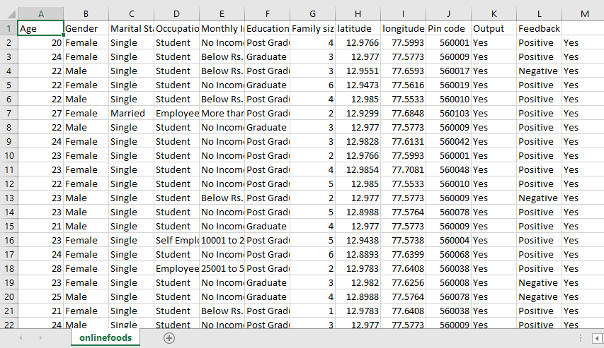
METHODOLOGY
The dataset used for this analysis was taking from an online source [Kaggle datasets] and will be used to perform the following analysis

Slide 5
KEY QUESTIONS
Which occupation orders food from online vendors most?
Which gender orders food from online vendor most?
Which of Monthly income and gender orders food most?

Slide 6
FINDINGS AND INSIGHTS

Slide 7
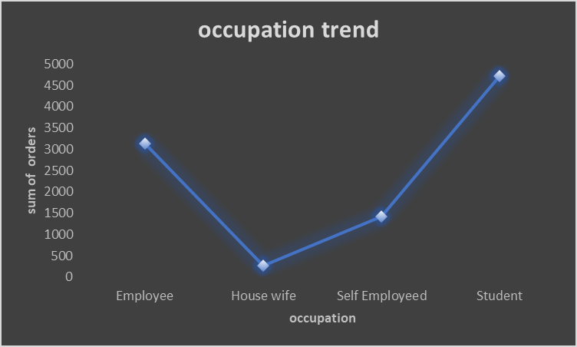
Which occupation orders food from online vendors most?
From the occupational trend in the chart it is found that students orders food from online vendors most with the highest number of orders and house wife orders the least in the trend.

Slide 8
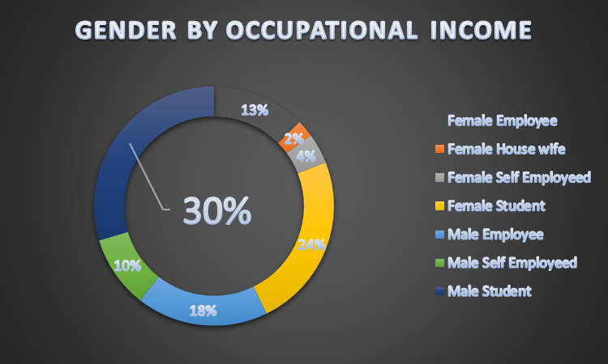
Which gender orders food from online vendor most?
It is found that male students with the highest percentage of about 30% mostly patronize online food vendors more, because most male student have little to zero cooking skills so they prefer to order online.

Slide 9
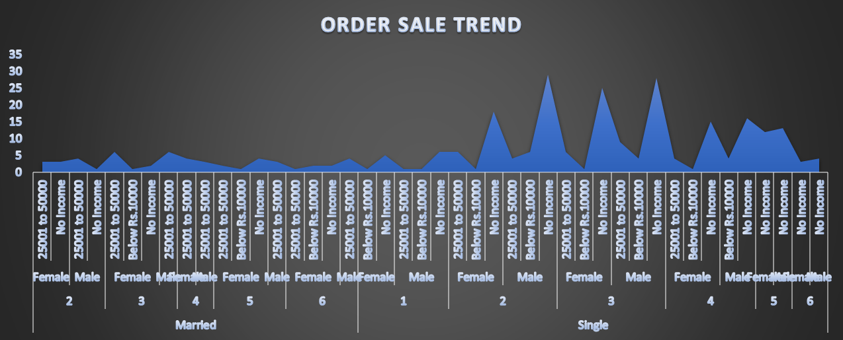
Which of Monthly income and gender orders food most?
This order trends confirmed our suspicion that single male with no monthly income orders foods from online vendors most, seeing that most students are sponsored by parents hence explains where there money comes from.

Slide 10
RECOMMENDATION
From the analysis made I believe that we now know that male students with no salary income orders from online food vendors most.
I recommend more online food outlets be opened close to schools as this will reduce delivery cost and improve profit for the business.

Slide 11
CONCLUSION
In conclusion the recommendation helps to boost income reduce expenditure and will provide more affordable food price for the students.

